Slide 1

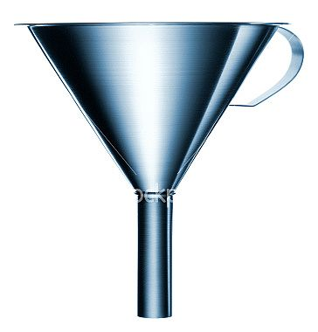
Current Reality
Desired Result
Point A
Point B
Hope
Hope
Hope

